Slide 1
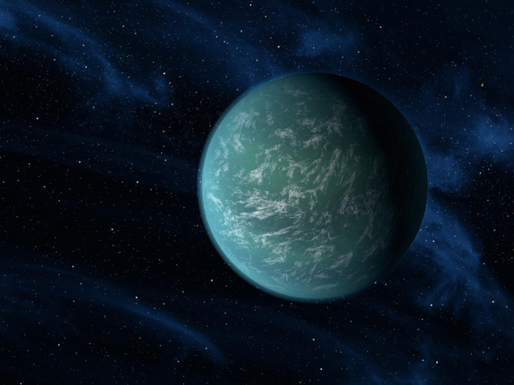
Understanding Evolution
The Story of
Life on Hound

Slide 2
The planet Hound was discovered in 2183 by a team visiting the planetary system around Sirius, the “dog star.” The team included a biologist (a person who studies living organisms), a paleontologist (a person who studies life in the past, often using fossils), and a planetary geologist (a person who studies the physical make-up of planets). On Hound, they found living organisms and evidence that organisms had been evolving there for millions of years. Using the same methods we use on Earth, they quickly set to work gathering information about how life might have developed.

Slide 3
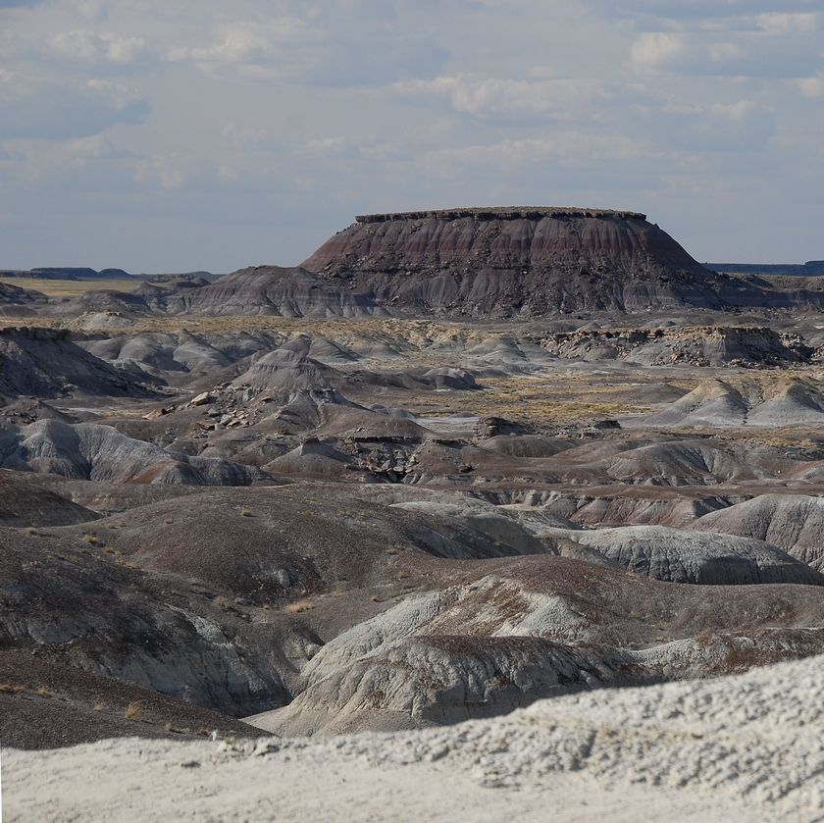
THE PRIMORDIAL ERA
In her excavations, the paleontologist found fossils only down to a certain level. Below that, there were no fossils. At the deepest layer with fossils, she found only fossils of organisms with curvy exteriors. The paleontologist deduced that these curvy organisms were the earliest forms of life on Hound.

Slide 4
THE PRIMORDIAL ERA
She only found plain circles, circles with a light sensor, and two ovals, one with a light sensor. It seems that all of these organisms made their own food either from light from the star Sirius or from chemicals on Hound. These life forms are called ‘producers’ because they produce their own food.

Slide 5
Organism #1
Organism #2

Slide 6
THE ICE AGE ERA
After many eons, Hound’s climate turned cold for about a million years; the geologist found evidence for an ice age. The larger, circle-shaped critters could store extra energy, but the oval-shaped critters couldn’t store nearly as much, and they became extinct. At the top of this layer, these were the only fossils present:

Slide 7
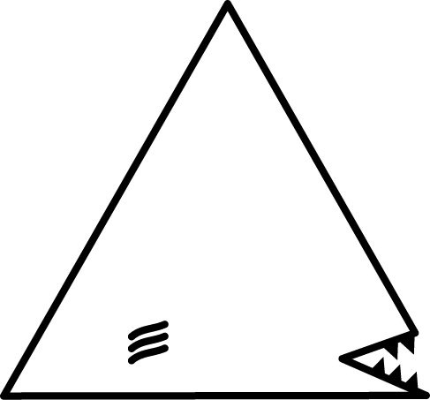
THE WARMING ERA
In the layer just above the Ice Age Era, bodies of all the ovals that died during the ice age had collected in cracks. This organic material was a plentiful food source for any organisms that could get at it. During this period, some of the plain circles had mutations that made them triangle shaped with mouths. Also, some of the circles with light sensors had a mutation that made them crescent shaped. The triangles’ and crescents’ points allowed them into cracks to absorb nutrients there. These organisms are ‘decomposers.’ At the top of this layer, these were the only fossils present:

Slide 8
THE PREDACEOUS ERA

Slide 9
PREDACEOUS ERA
The layer above the Warming Era showed evidence that the triangles also ate the circles. The triangles had become a special kind of consumer called a predator as well as a decomposer. As predators, they ate all of the plain circles. However, circles and crescents with light sensors saw the triangles coming and escaped. During this era, some circles with light sensors had a mutation that produced squiggles with light sensors that could crawl into cracks to eat some (but not all) of the crescents. These squiggles built up in the population and became a new predator. At the top of this layer, these fossils were present:

Slide 10
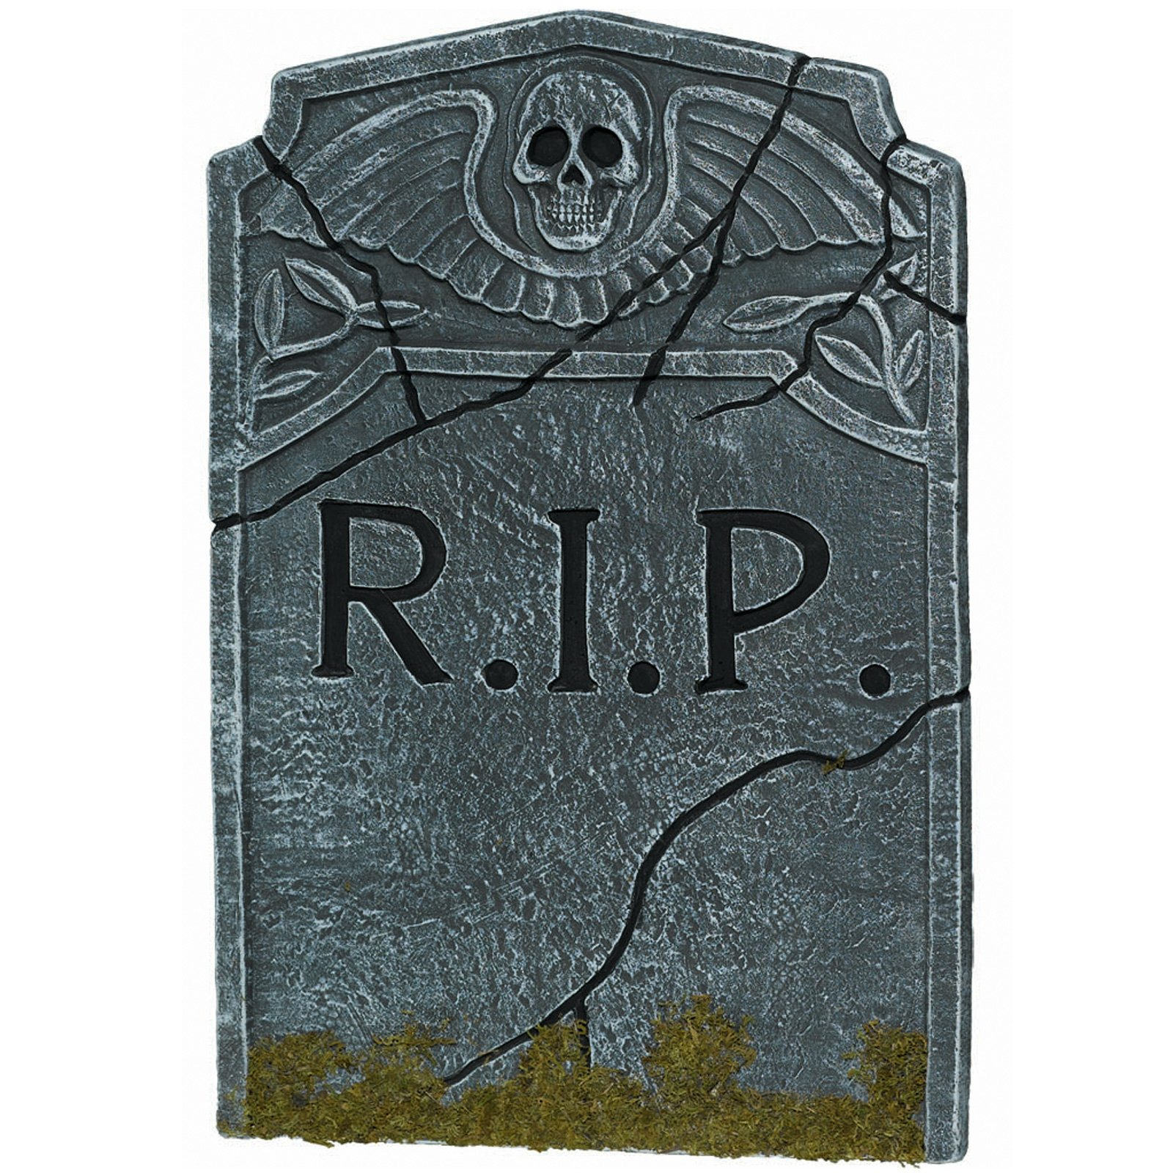
THE MORTALITY ERA

Slide 11
THE MORTALITY ERA
The layer of rock just above the Predaceous Era held evidence that the squiggles were ferocious and very hungry. It appears that they ate every crescent they could find. In fact, they ate so many that the crescents could no longer find mates and reproduce, and they went extinct. With nothing to eat, the squiggles also perished. At the top of this layer, only these fossils were present:

Slide 12
THE ANGLIFEROUS ERA
In the layer of rock just above the Mortality Era, there was evidence that some triangles were born with a mutation for jaggedness. With so many dead crescents and squiggles, there was plentiful food in the cracks. Two kinds of jagged organisms began to build up in the triangle population, some with sound sensors and some without. Eventually, these became two new species. At the top of this layer, these fossils were present:

Slide 13
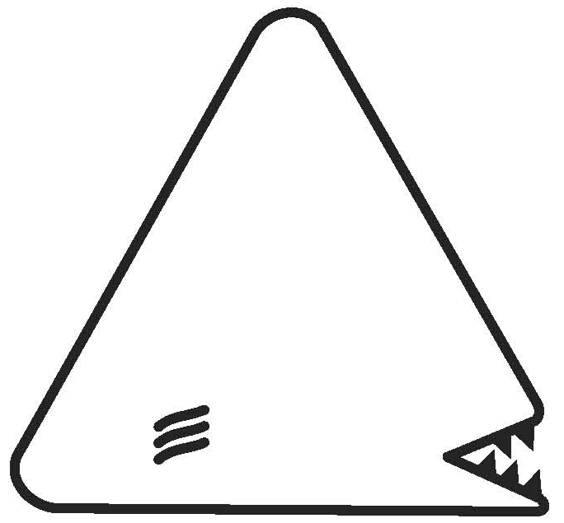
MODERN ERA
When the team landed, they found only circles with light sensors, rounded triangles, and jaggeds with sound sensors. The triangles hunted the jaggeds with no sound sensors to extinction. The pointy-edged triangles made a scraping sound when they moved, and the jaggeds with sound sensors could hear them coming and escape. Eventually, so many pointy triangles starved that they became extinct. However, a few mutant triangles had rounded points that made them quiet enough to sneak up on jaggeds with sound sensors, and these survived. These are the only organisms the team found alive on Hound when they landed:

